Slide 1
Course Title: Reward Management
Lecture 2
Total Reward,
Strategic Reward

Slide 3
Total Reward
The total reward concept emphasizes the importance of considering all aspects of reward as an integrated and coherent whole.
Each of the elements of total reward, namely base pay, pay contingent on performance, competence or contribution, employee benefits and non-financial rewards, which include intrinsic rewards from the employment environment and the work itself, are linked together.

Slide 4
Total Reward
Creating a fun, challenging, and empowered work environment in which individuals are able to use their abilities to do meaningful jobs for which they are shown appreciation is likely to be a more certain way to enhance motivation and performance – even though creating such an environment may be more difficult and take more time than simply turning the reward lever.

Slide 5
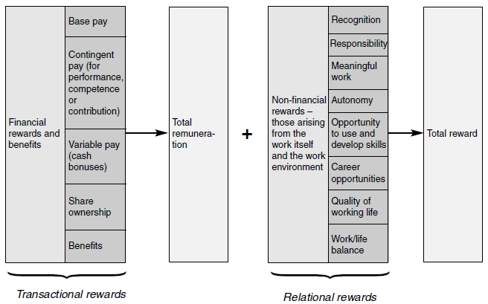
COMPONENTS OF TOTAL REWARDS

Slide 6
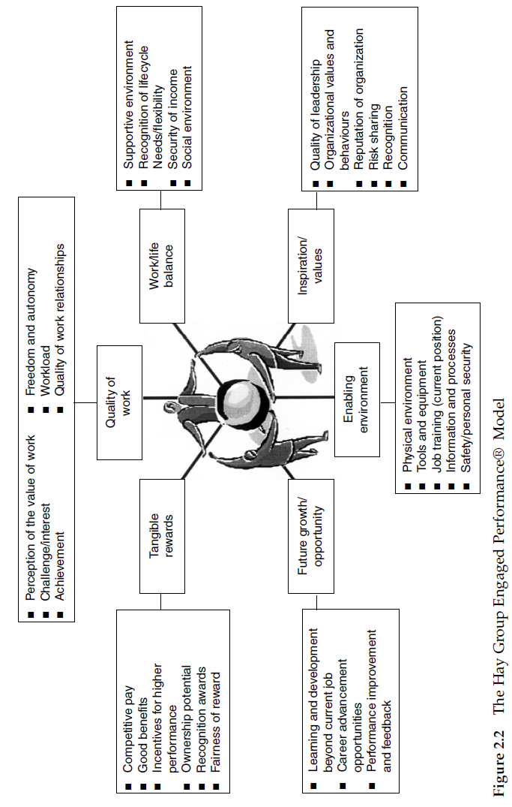

Slide 7
BENEFITS OF A TOTAL REWARD APPROACH
Greater impact
Enhancing the employment relationship
Increased engagement as part of the process
Flexibility to meet individual
Winning the war for talent

Slide 8
Strategic Reward
Strategic reward management is the process of looking ahead at what an organization needs to do about its reward policies and practices in the middle or relatively distant future.
Strategic reward management deals with both ends and means. As an end it describes a vision of what reward policies will look like in a few years’ time. As a means, it shows how it is expected that the vision will be realized.
Strategic reward management is therefore visionary management, concerned with creating and conceptualizing ideas of what the organization should be doing about valuing and rewarding its people.

Slide 9
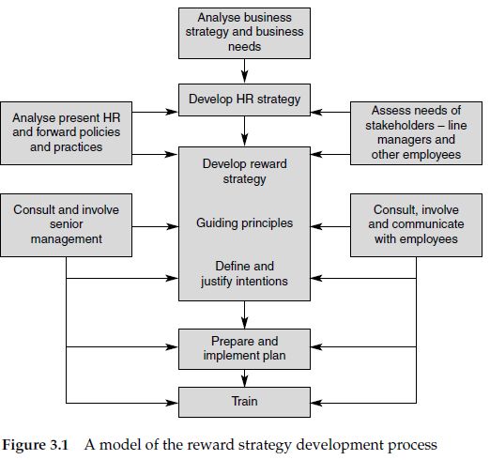

Slide 10
CRITERIA FOR AN EFFECTIVE REWARD STRATEGY
1. They have to have clearly defined goals and a well-defined link to business objectives.
2. There have to be well-designed pay and reward programmes, tailored to the needs of the organization and its people, and consistent and integrated with one another.
3. Perhaps most important and most neglected, there need to be effective and supportive HR and reward processes in place.

